Slide 1
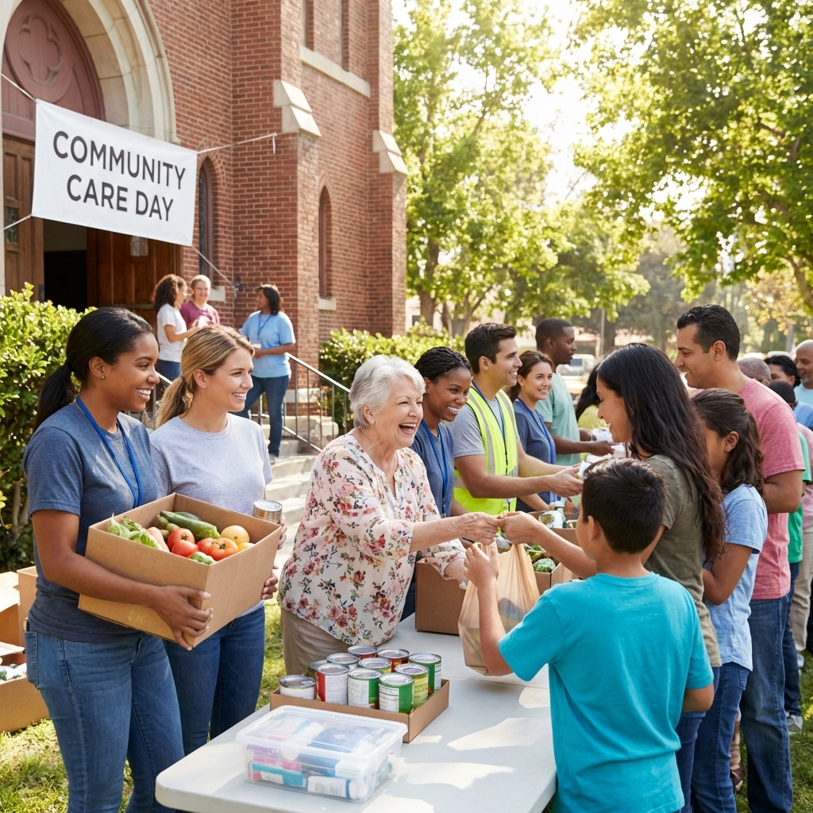
LA COSECHA COMMUNITY CHURCH
The DiaBuddy Experience
and The Harvest Project
Health. Service. Stewardship. Impact.
A community strategy to prepare health advocates, expand access to RemoteCare, and advance the $1,000,000 building fund goal.
www.lacosechacommunitychurch.com
Notes:
Opening: present one vision connecting wellness, service, and community building.
[Sources]
- Spanish source deck
[/Sources]

Slide 2
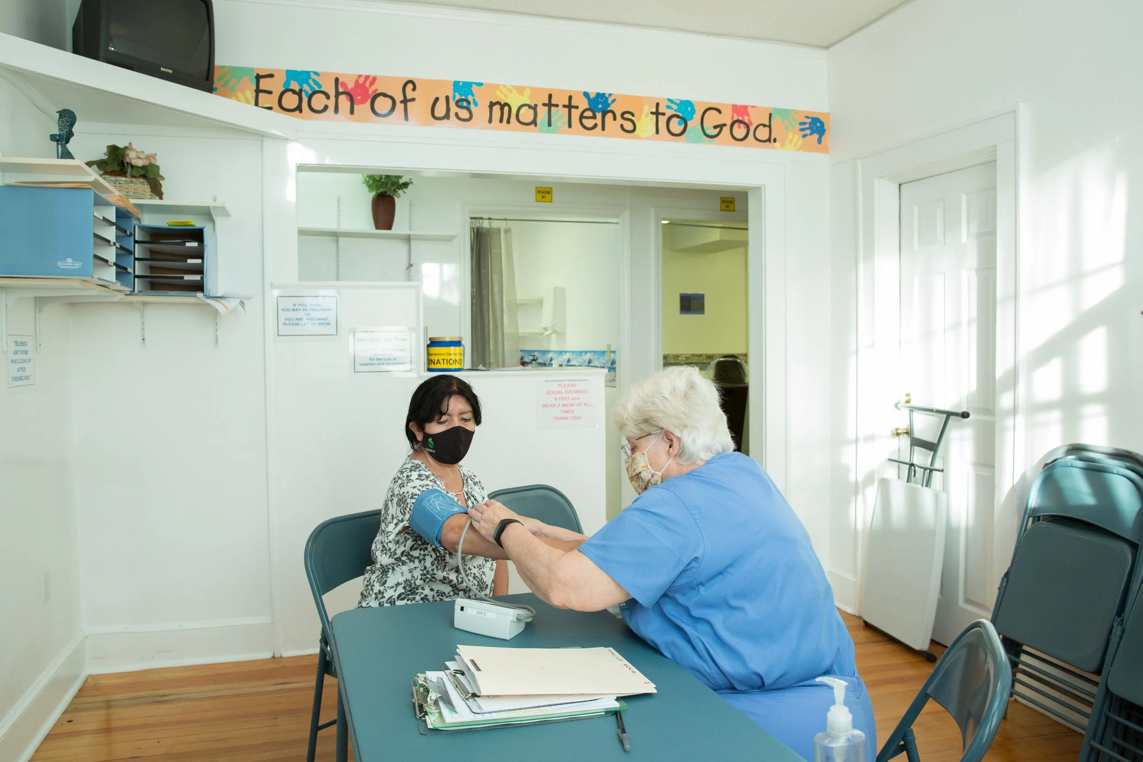
The opportunity: care for people while building the future
One integrated mission for Hempstead and beyond.
It is more than technology.
It is more than a campaign.
It is a community ecosystem.
FAITH
Serve with compassion and purpose.
HEALTH
Connect prevention, education, and remote support.
HARVEST
Turn every relationship into community impact.
La Cosecha Community Church • The DiaBuddy Experience
02
Notes:
Connect the pastoral vision with a practical community outreach model.
[Sources]
- Spanish source deck
[/Sources]

Slide 3
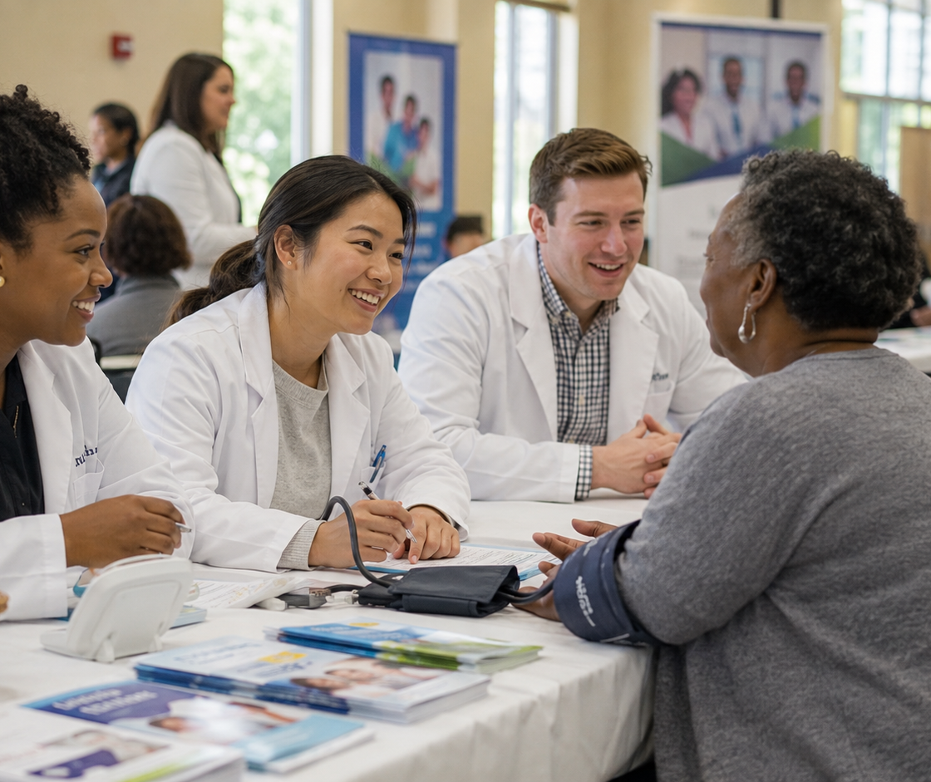
RemoteCare makes service scalable and continuous
Care can follow people where they live, study, work, and worship.
REACH
Serve the community inside and beyond the building.
CONTINUITY
Sustain education, follow-up, and human connection.
ACCESS
Reduce barriers of distance and scheduling.
COMMUNITY
Mobilize students, professionals, churches, and partners.
Technology expands reach; relationships build trust.
La Cosecha Community Church • The DiaBuddy Experience
03
Notes:
Explain RemoteCare in human terms without promising clinical outcomes.
[Sources]
- Spanish source deck
[/Sources]

Slide 4
The prevention journey becomes a journey of service
Every step creates an opportunity to help and activate another person.
1
2
3
4
5
Risk Test
Connect
DPP
DSP
Impact
Know the risk
Initial guidance
Sustainable habits
Service and advocacy
Strengthen community
Public goal: know the risk. Ministry goal: prepare people to support the next step.
La Cosecha Community Church • The DiaBuddy Experience
04
Notes:
Present the pathway as education and connection, not diagnosis.
[Sources]
- Spanish source deck
[/Sources]

Slide 5

A DiaBuddy Service Provider serves as educator, connector, and advocate
Certification supports practical preparation; it does not expand legal scope of practice.
EDUCATE
Share the risk-awareness and prevention message.
CONNECT
Guide people toward appropriate next steps.
SUPPORT
Support participation through RemoteCare tools.
ADVOCATE
Champion prevention and wellness in the church and community.
La Cosecha Community Church • The DiaBuddy Experience
05
Notes:
Emphasize professional boundaries, supervision, privacy, and responsible escalation.
[Sources]
- Spanish source deck
[/Sources]

Slide 6
ONE CHURCH • TWO CALLS • ONE MISSION
Prepare servants.
Fund the future.
CALL 1
CALL 2
Activate DSPs
Sow into the building
Prepare members, students, and professionals to educate, connect, and support.
Direct contributions, sponsorships, and DPP impact toward the building fund goal.
Service builds relationships. Relationships multiply the harvest.
Notes:
Transition: show how the health model and The Harvest Project strengthen each other.
[Sources]
- Spanish source deck
[/Sources]

Slide 7
The Harvest Project: a $1,000,000 foundational campaign
Build the center. Develop people. Serve the community.
$1,000,000
Building fund goal
100 Founders
$3K • $5K • $10K
Corporate sponsorships
$10K • $25K • $50K+
DPP Chai for Life
$180/year • $18/month
General contributions
Any amount with purpose
La Cosecha Community Church • The DiaBuddy Experience
07
Notes:
Present the goal and previously approved contribution pathways. Confirm official giving mechanisms before public use.
[Sources]
- Spanish source deck
[/Sources]

Slide 8
The 100 Founders
One hundred leadership contributors form the campaign’s first public circle.
100
$3,000
$5,000
$10,000
La Cosecha Founding Partners
Seed Partner
Growth Partner
Harvest Partner
Each partner can give at one of three levels. Together, the 100 Founders establish credibility, urgency, and a story others can join.
Plants the vision and helps launch the campaign.
Supports expanded outreach, education, and mobilization.
Provides leadership momentum toward the $1M goal.
Contributor message: “I helped plant the Harvest.”
La Cosecha Community Church • The DiaBuddy Experience
08
Notes:
Restore the three approved family levels: Seed, Growth, and Harvest.
[Sources]
- Spanish source deck
[/Sources]

Slide 9

Corporate Sponsorships
A separate pathway for employers, pharmacies, health organizations, churches, and foundations.
Corporate partners help us reach people, improve health, and fund the Harvest.
SILVER
$10,000
Community outreach and risk-test activation
GOLD
$25,000
DPP + DSP expansion and campaign leadership
PLATINUM
$50,000+
Transformational development partner
The DiaBuddy Experience is positioned as the inaugural Gold Corporate Founding Partner.
www.diabuddyproject.com
La Cosecha Community Church • The DiaBuddy Experience
09
Notes:
Restore the approved corporate levels: Silver, Gold, and Platinum.
[Sources]
- Spanish source deck
[/Sources]

Slide 10
The DPP Chai for Life initiative turns prevention into legacy
The number 18 symbolizes life—and every enrollment can sow health and impact.
$180
$18/month
Annual plan
Monthly Chai plan
$90 directed to The Harvest Project
50% directed to The Harvest Project
HONOR A LIFE • PROTECT A LIFE • CHANGE A LIFE
La Cosecha Community Church • The DiaBuddy Experience
10
Notes:
Chai (18) means life. Confirm current pricing, eligibility, and terms before publishing or accepting enrollments.
[Sources]
- Spanish source deck
[/Sources]

Slide 11
The Harvest Multiplier shows how impact can grow
Illustrative example based on $90 per annual participant directed to the project.
100 participants
$9,000
500 participants
$45,000
1,000 participants
$90,000
5,000 participants
$450,000
11,112 participants
$1,000,080
A nationwide network can turn responsible prevention into recurring support for the center.
La Cosecha Community Church • The DiaBuddy Experience
11
Notes:
Illustrative calculation: participants × $90 per annual participant. This is not a guaranteed projection.
[Sources]
- Spanish source deck
[/Sources]

Slide 12
A 90-day activation plan can begin inside the church
Start small, learn quickly, and scale responsibly.
DAYS 1–30
DAYS 31–60
DAYS 61–90
Prepare
Activate
Multiply
Appoint leaders, review resources, and form the initial team.
Offer risk tests, guidance, and information sessions.
Certify DSPs, activate partners, and present contribution opportunities.
First outcome: a pilot team, a clear pathway, and an impact story the congregation can share.
La Cosecha Community Church • The DiaBuddy Experience
12
Notes:
Facilitate a leadership conversation to assign responsibilities, calendar, privacy, and follow-up.
[Sources]
- Spanish source deck
[/Sources]

Slide 13
Stewardship and transparency sustain trust
Every contributor deserves clarity about health, service, and financial impact.
FINANCIAL DASHBOARD
Funds raised, expenses, and allocations.
IMPACT DASHBOARD
Tests, enrollments, participation, and active DSPs.
STORIES WITH PERMISSION
Approved testimonials with privacy protected.
MILESTONE REPORT
Building progress, partnerships, and next steps.
Recommended promise: publish a regular Harvest Project Impact Report.
La Cosecha Community Church • The DiaBuddy Experience
13
Notes:
Define campaign governance, pastoral approval, financial controls, consent, and privacy before launch.
[Sources]
- Spanish source deck
[/Sources]

Slide 14
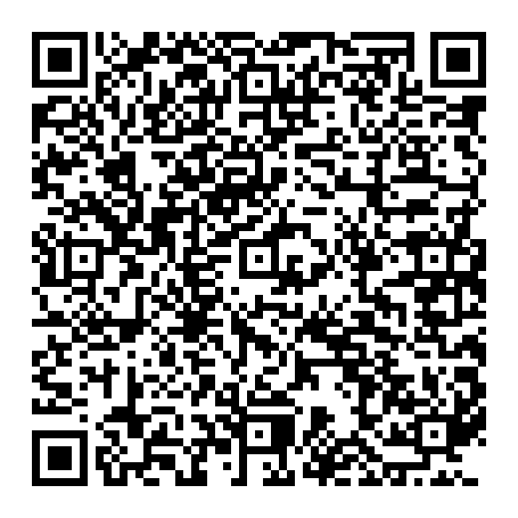
Opportunity: DiaBuddy Service Provider (DSP)
English summary of the official uRecruits posting. Applications are completed through the official link.
REMOTE
Independent contractor • Flexible shift
A non-accredited certification program for the next generation of healthcare professionals and pharmacy leaders.
PURPOSE
Learn.
Serve.
Earn income.
The self-paced online course develops skills in digital health, wellness coaching, and patient engagement. It also teaches participants how to manage their own DSP business.
50 openings • Immediate start • Listed experience: 0–2 years
La Cosecha Community Church • The DiaBuddy Experience
14
Notes:
Present an accurate summary of the official uRecruits description and listed terms. The official page controls current terms.
[Sources]
- Spanish source deck
[/Sources]

Slide 15
Who should apply?
Designed for pharmacists, pharmacy students, interns, and postgraduate candidates.
✓
Views telehealth as a new standard of care.
✓
Wants to build more human connections through technology.
✓
Recognizes the home as a valid ambulatory-care location.
✓
Has an entrepreneurial mindset and wants to understand modern healthcare.
✓
Believes prevention can reduce risk and improve health.
✓
Values flexibility, autonomy, and performance-based rewards.
La Cosecha Community Church • The DiaBuddy Experience
15
Notes:
Describe the intended applicant profile using approved prevention language focused on reducing risk and supporting wellness.
[Sources]
- Spanish source deck
[/Sources]

Slide 16
What you will do as a DiaBuddy Service Provider
Guide, educate, and support using approved materials and processes.
INTRODUCE
Introduce approved digital plans: DPP, GLP-1 education, weight-management support, and wellness.
GUIDE
Help people understand options and navigate enrollment.
SUPPORT
Encourage engagement and provide compassionate remote follow-up.
COMPLY
Use approved scripts, materials, workflows, and privacy standards.
La Cosecha Community Church • The DiaBuddy Experience
16
Notes:
Summarize the primary responsibilities from the official posting without expanding anyone’s clinical or professional scope.
[Sources]
- Spanish source deck
[/Sources]

Slide 17
Skills, benefits, and terms
A remote, flexible, purpose-driven opportunity.
MUST-HAVE SKILLS
LISTED BENEFITS
• Strong communication
• Flexible income opportunity
• Professionalism and empathy
• Training and mentorship
• Comfort with outreach and networking
• Purpose-driven service
• Basic digital literacy
• Remote work and flexible schedule
• Self-management and accountability
• Student-loan debt support resources
• Respect for privacy and dignity
Bachelor’s degree • Independent contractor • Listed compensation: $1.2K–$120K/year, negotiable
La Cosecha Community Church • The DiaBuddy Experience
17
Notes:
Present listed skills, benefits, and terms. Clarify that official terms may change and compensation is not guaranteed.
[Sources]
- Spanish source deck
[/Sources]

Slide 18
About The DiaBuddy Experience
A company with a heart for those who serve and those receiving support.
Ken Sternfeld’s story connects pharmacy, innovation, faith, and service.
01
Inspired by his pharmacist father and the care he provided to his community.
02
Experience as a pharmacist, emerging leader, and mentor to healthcare professionals.
03
Early participation in implementing Chronic Care Management.
04
A personal commitment to honor loved ones affected by diabetes.
05
Mission: delay the onset and reduce the risk of type 2 diabetes through prevention, education, and support.
La Cosecha Community Church • The DiaBuddy Experience
18
Notes:
Summarize the company story and the project’s approved mission language.
[Sources]
- Spanish source deck
[/Sources]

Slide 19
YOUR GATEWAY TO THE PROJECT
Become a DiaBuddy
Service Provider (DSP)
As a DSP, you can participate in the full ecosystem: prevention, RemoteCare, DPP, community outreach, and The Harvest Project.
APPLY TODAY
https://urecruits.com/company/the-diabuddy-experience/job/diabuddy-service-provider-dsp/remote?jid=7572
SCAN TO APPLY
One application. One clear pathway. One way to serve.
Share the link with members, students, professionals, and partners.
Notes:
Primary call to action: apply to become a DiaBuddy Service Provider. Present the DSP application as the gateway to participate in the entire project.
[Sources]
- Spanish source deck
[/Sources]

Slide 20
THE NEXT STEP
Plant the seed.
Activate service.
Build the future.
Proposed decision
Authorize a 90-day pilot team to integrate DiaBuddy DSP, RemoteCare, and The Harvest Project.
APPLY TO BECOME A DSP: https://urecruits.com/company/the-diabuddy-experience/job/diabuddy-service-provider-dsp/remote?jid=7572
www.lacosechacommunitychurch.com
600 Greenwich Street, Hempstead, NY 11550 • (516) 292-1780
Notes:
Close with a specific decision: appoint the pilot team, schedule a working meeting, and validate calls to action and official giving pathways.
[Sources]
- Spanish source deck
[/Sources]

